Slide 1


Does Learning Require Memorization?
A short tale about a long tail
_{Vitaly Feldman}
_{Research}
_{Brain team}
_{with Chiyuan Zhang}

Slide 2
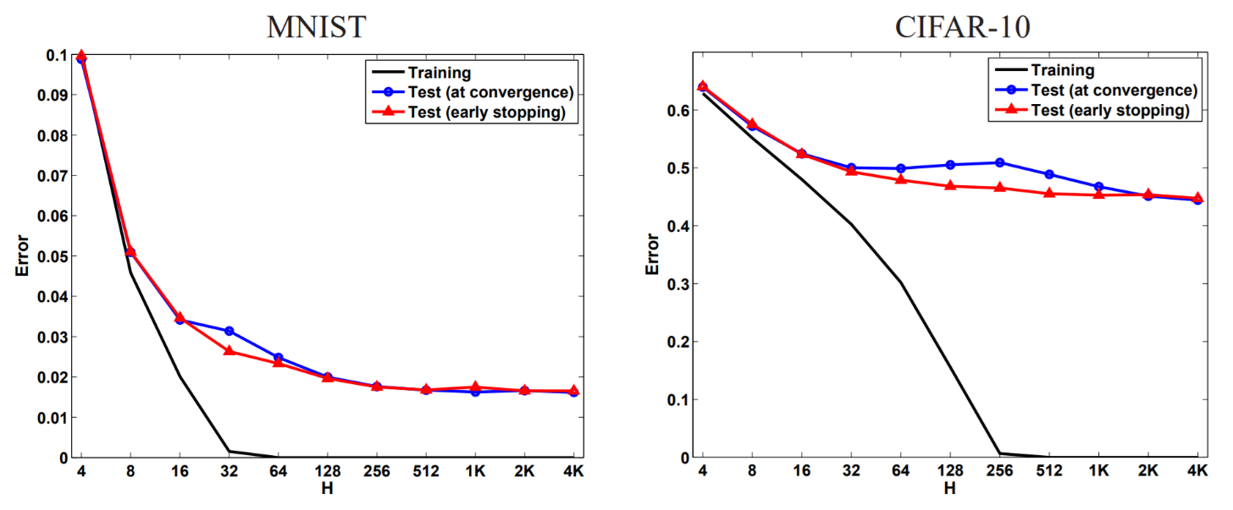
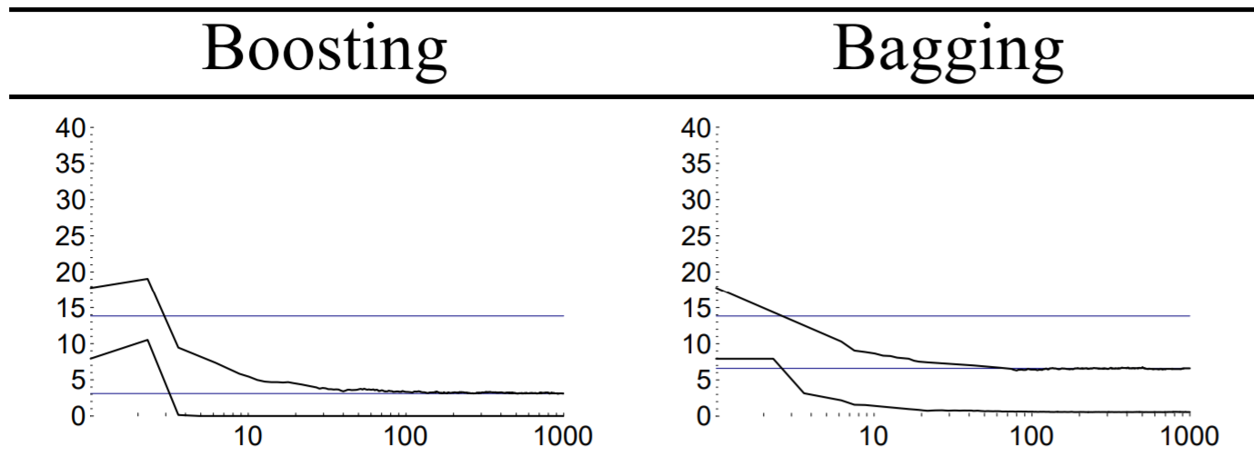
(Over?)fitting the dataset
UCI: letter recognition
[Schapire,Freund,Bartlett,Lee ‘98]
[Neyshabur,Tomioka,Srebro ‘15]
Inception on Imagenet-1000 with random labels:
Training error: 9% Test error: 99.9%
[Zhang,Bengio,Hardt,Recht,Vinyals ‘17]

Slide 3

Privacy concerns
Black-box membership inference attack with high accuracy
[Shokri,Stronati,Song,Shmatikov 17; LongBWBWTGC 18; SalemZFHB 18,…]
Is memorization necessary for achieving optimal error?
Notes:
Concrete question

Slide 4
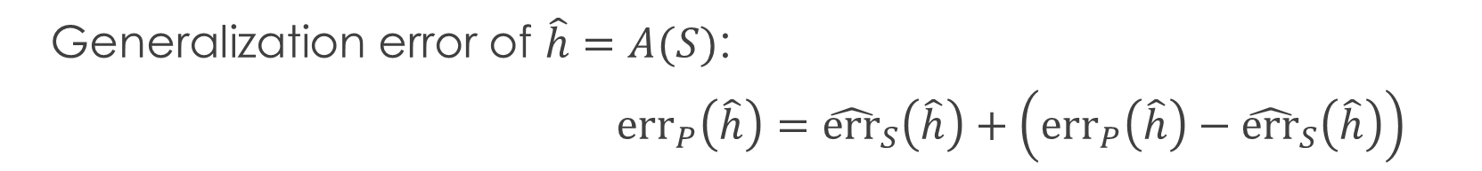
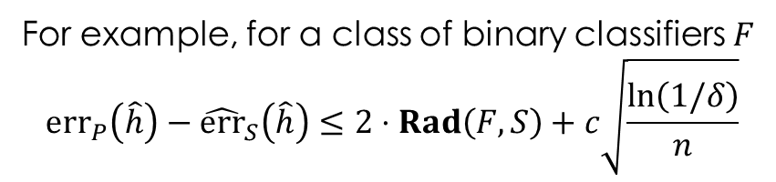
What about theory?
Generalization error of $\hat{h}=A(S)$:
${err}_{P}\left(\hat{h}\right)={\hat{err}}_{S}\left(\hat{h}\right)+\left({err}_{P}\left(\hat{h}\right)−{\hat{err}}_{S}\left(\hat{h}\right)\right)$
empirical
error
generalization gap
Controlled via a proxy
VC-dim, margin, norms
stability etc.
For example, for a class of binary classifiers $F$
$${err}_{P}\left(\hat{h}\right)−{\hat{err}}_{S}\left(\hat{h}\right)≤2⋅Rad\left(F,S\right)+c\sqrt{\frac{ln\left(1/δ\right)}{n}}$$

Slide 5
Related work
Generalization of interpolating methods
Interpolation may be “harmless”
Does not address the “why?” question
Memorization also happens without interpolation
Overparametrization is useful
Does not imply interpolation
Computational benefits of interpolation
SGD converges faster on some convex realizable problems
Little empirical support in the context of DNNs
[Cover,Hart ’67; Belkin,Hsu,Mitra ‘18;
Liang,Rakhlin ’18; Belkin,Rakhlin,Tsybakov ’19;
Belkin,Hsu,Xu ’19; Bartlett,Long,Lugosi,Tsigler ‘19;
Hastie,Montanari,Rosset,Tibshirani ’19;
Muthukumar,Vodrahalli,Sahai ‘19….]
[Ma,Bassily,Belkin ’18]

Slide 6
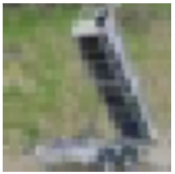
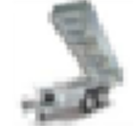

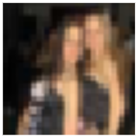

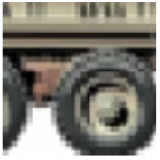
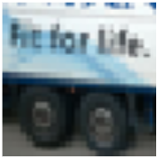
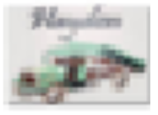
Hard rare examples
CIFAR-10 truck class
training set
test set

Slide 7
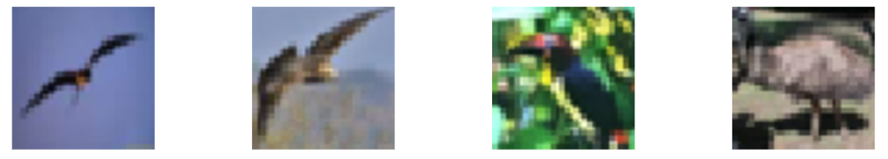
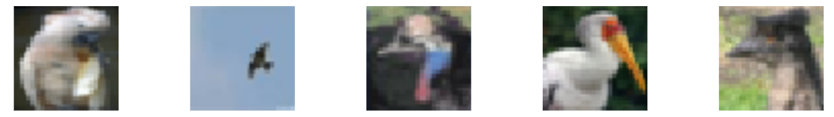
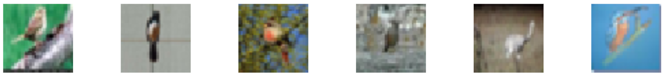
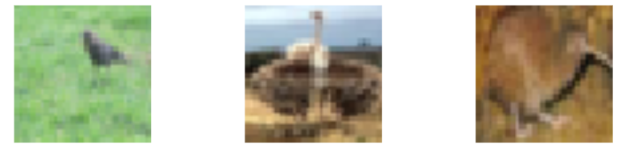
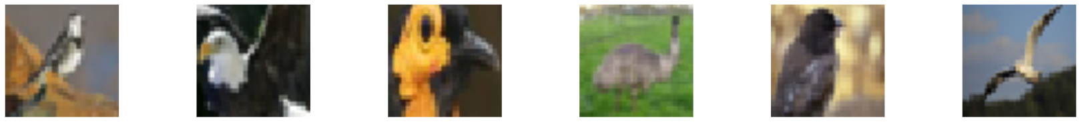
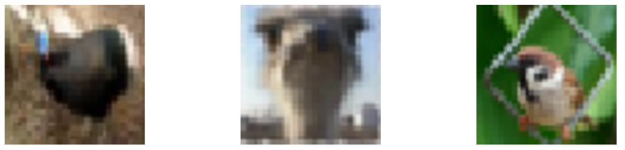
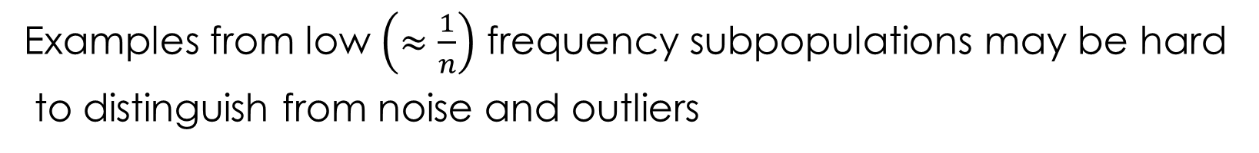
Subpopulations
CIFAR-10 birds
Examples from low $\left(≈\frac{1}{n}\right)$ frequency subpopulations may be hard
to distinguish from noise and outliers

Slide 8
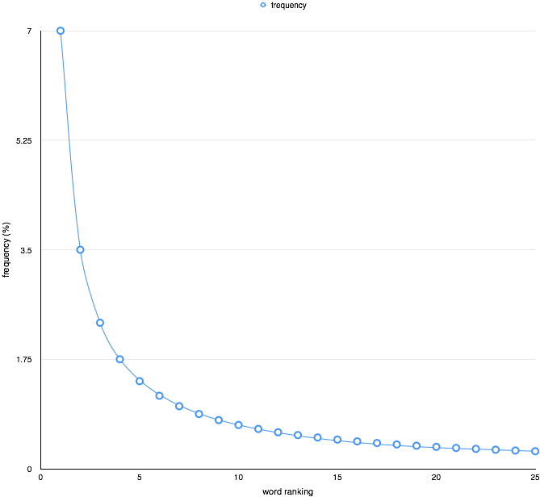
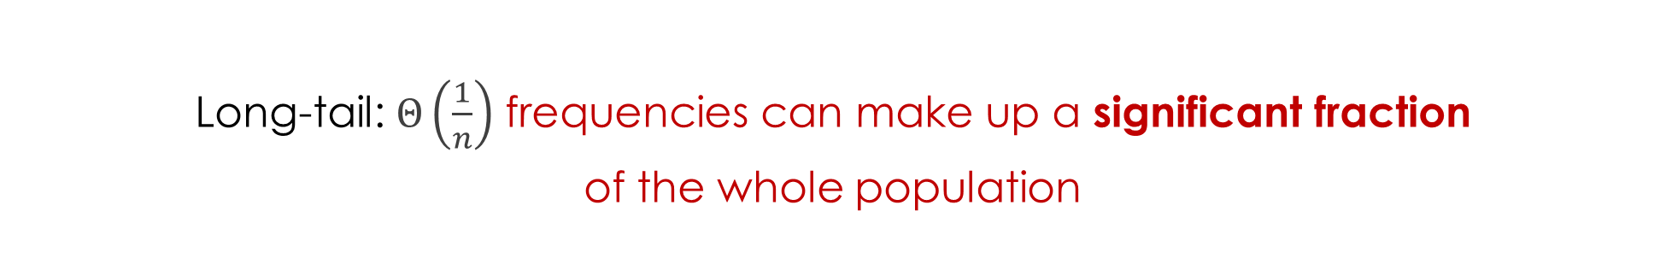
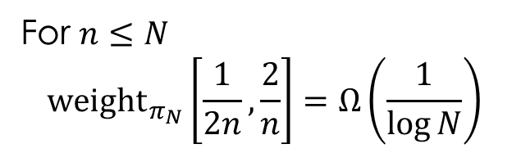
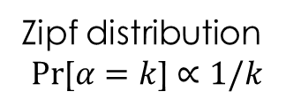
The tail rears its head
Long-tail: $Θ\left(\frac{1}{n}\right)$ frequencies can make up a significant fraction
of the whole population
For $n≤N$
$$\underset{}{{weight}_{π_{N}}}\left[\frac{1}{2n},\frac{2}{n}\right]=Ω\left(\frac{1}{\log{N}}\right)$$
Zipf distribution
$$Pr\text{[}α=k\text{]}∝1/k$$

Slide 9
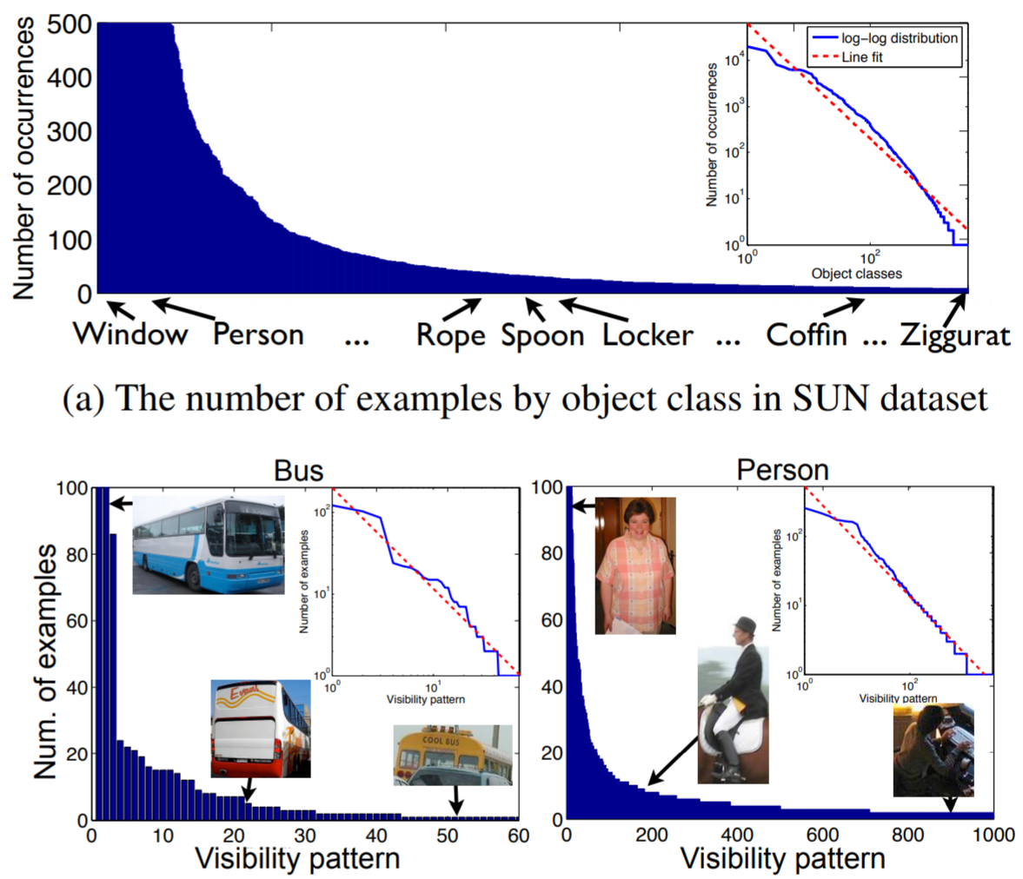
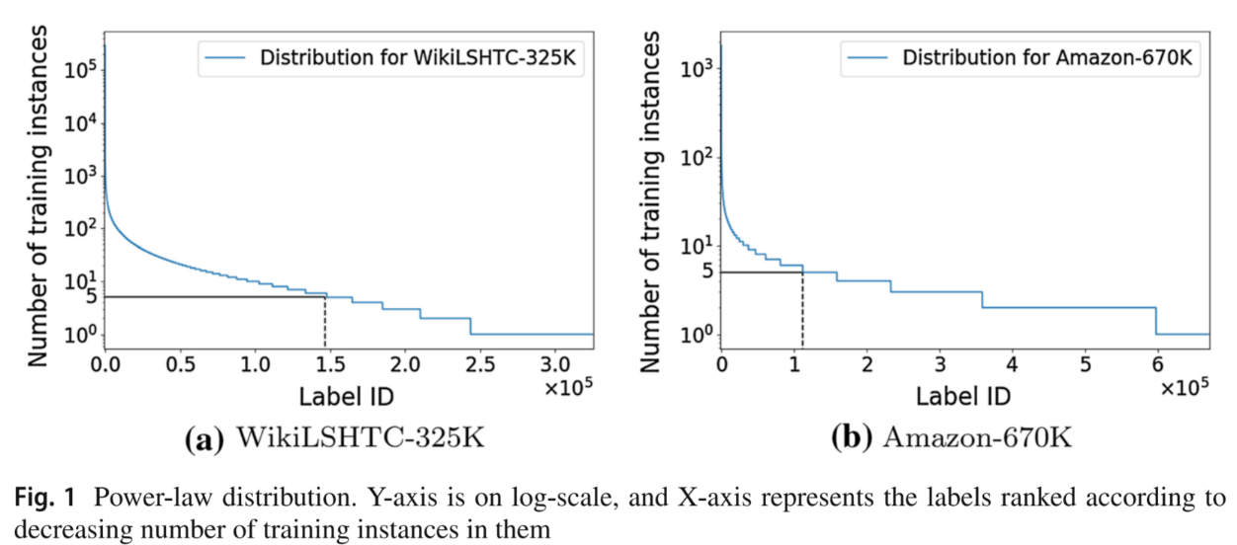
Long-tailed data
Additional annotations
Extreme multiclass problems
[Zhu, Anguelov, Ramanan ’14]
[Babbar,Scholkopf ‘19]

Slide 10
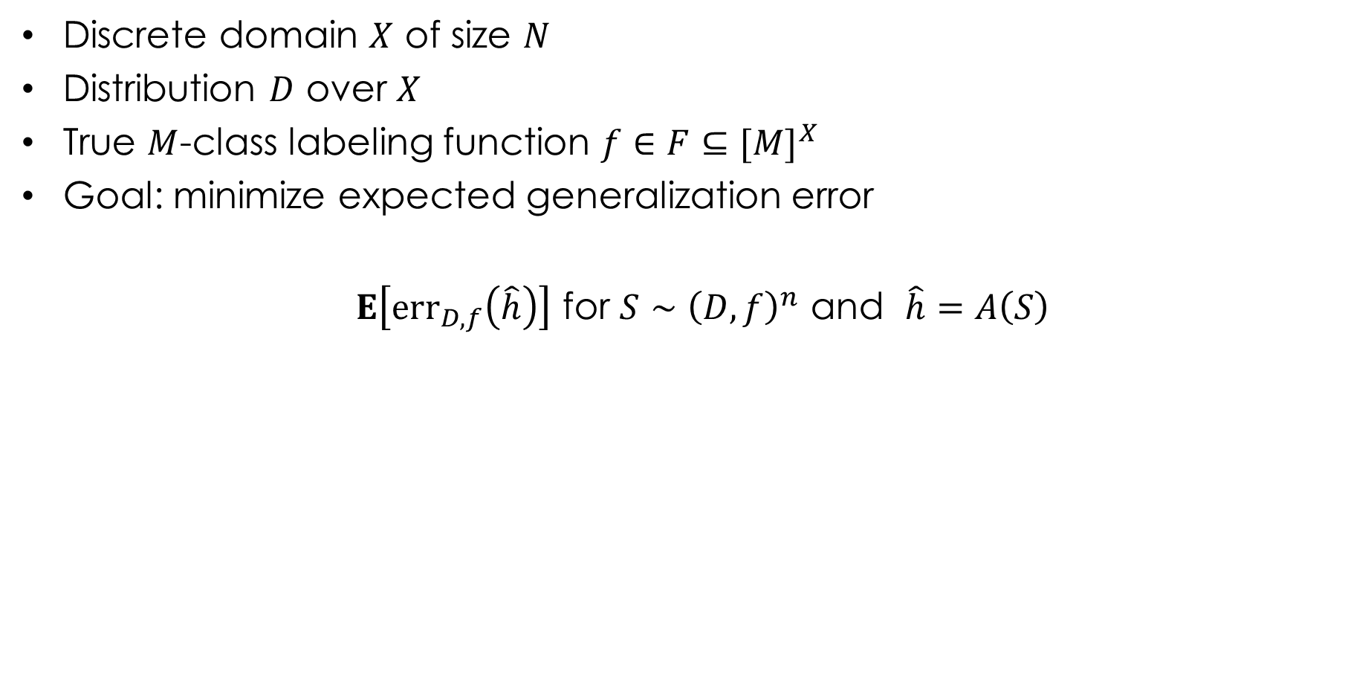
Basic model
Discrete domain $X$ of size $N$
Distribution $D$ over $X$
True $M$-class labeling function $f∈F⊆{[M]}^{X}$
Goal: minimize expected generalization error
$E\left[{err}_{D,f}\left(\hat{h}\right)\right]$ for $S∼{\left(D,f\right)}^{n}$ and $\hat{h}=A\left(S\right)$

Slide 11
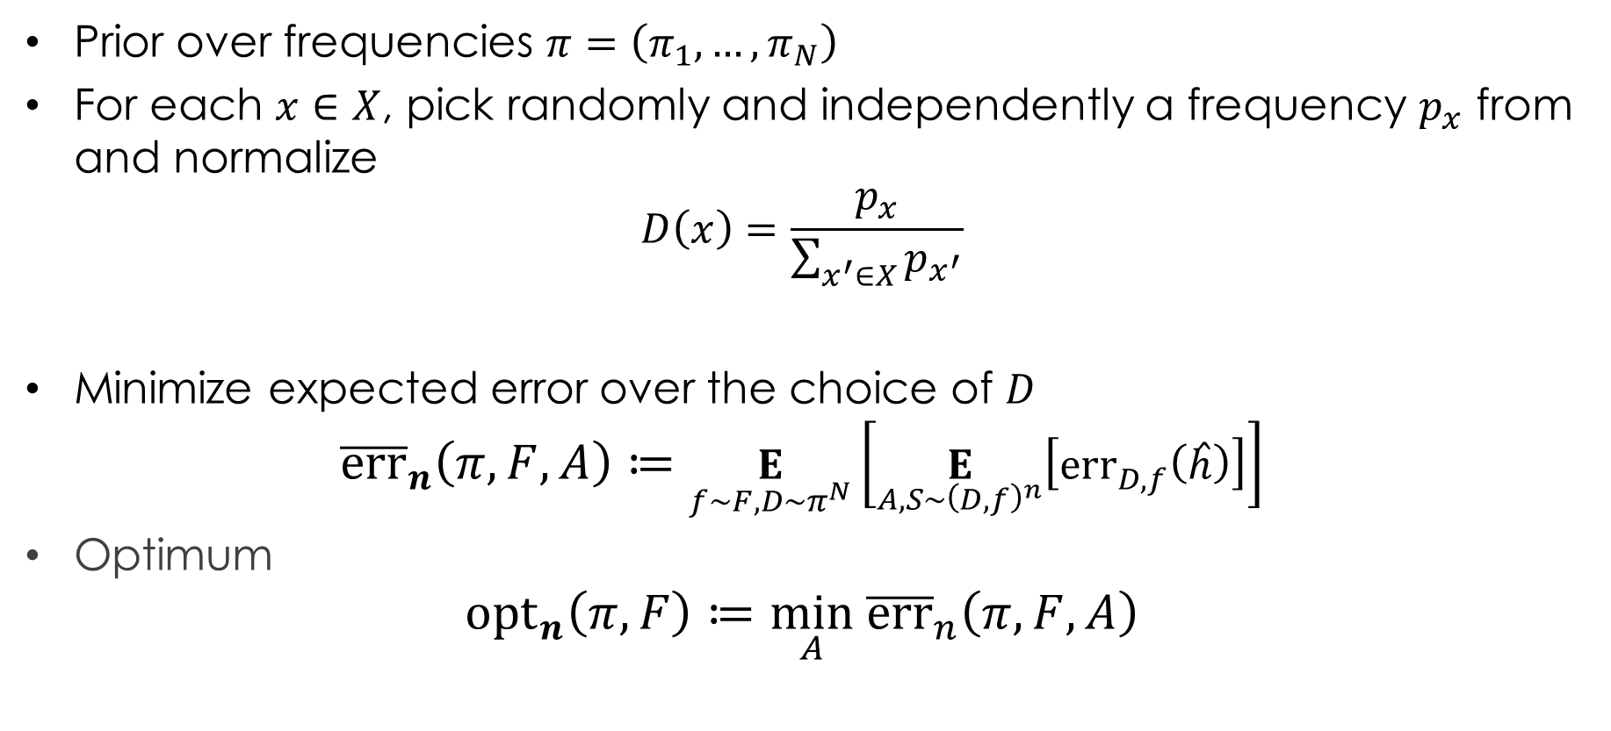
Prior over distributions
Prior over frequencies $π=\left(π_{1},…,π_{N}\right)$
For each $x∈X$, pick randomly and independently a frequency $p_{x}$ from and normalize
$$D\left(x\right)=\frac{p_{x}}{\sum_{x^{′}∈X}{p_{x^{′}}}}$$
Minimize expected error over the choice of $D$
$${\overline{err}}_{n}\left(π,F,A\right)≔\underset{f∼F,D∼π^{N}}{E}\left[\underset{A, S∼{\left(D,f\right)}^{n}}{E}\left[{err}_{D,f}\left(\hat{h}\right)\right]\right]$$
Optimum
$${opt}_{n}\left(π,F\right)≔\min_{A} {\overline{err}}_{n}\left(π,F,A\right)$$

Slide 12
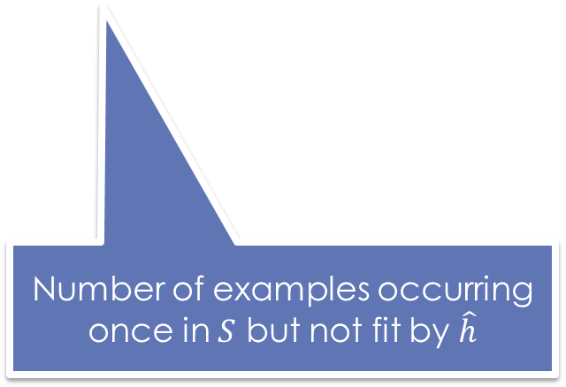
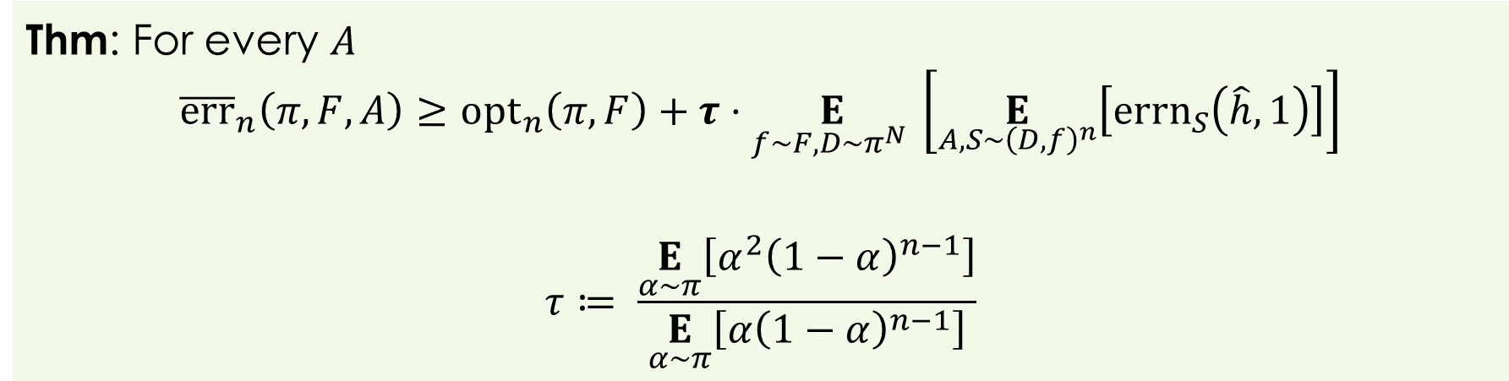
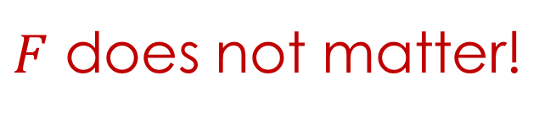
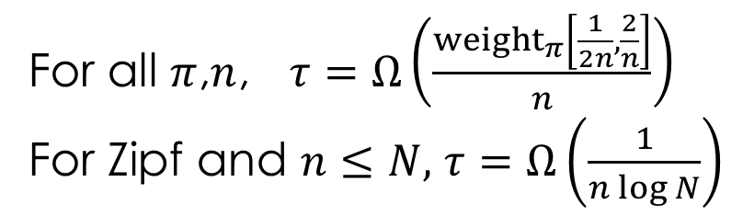
Benefits of fitting
Thm: For every $A$
$${\overline{err}}_{n}\left(π,F,A\right)≥{opt}_{n}\left(π,F\right)+τ⋅\underset{f∼F,D∼π^{N} }{E}\left[\underset{A,S∼{\left(D,f\right)}^{n}}{E}\left[{errn}_{S}\left(\hat{h},1\right)\right]\right]$$
$$τ≔ \frac{\underset{α∼π}{E}\left[α^{2}{\left(1−α\right)}^{n−1}\right]}{\underset{α∼π}{E}\left[α{\left(1−α\right)}^{n−1}\right]}$$
Number of examples occurring once in $S$ but not fit by $\hat{h}$
For all $π$,$n$, $τ=Ω\left(\frac{{weight}_{π}\left[\frac{1}{2n},\frac{2}{n}\right]}{n}\right)$
For Zipf and $n≤N,$ $τ=Ω\left(\frac{1}{n\log{N}}\right)$
$F$ does not matter!

Slide 13
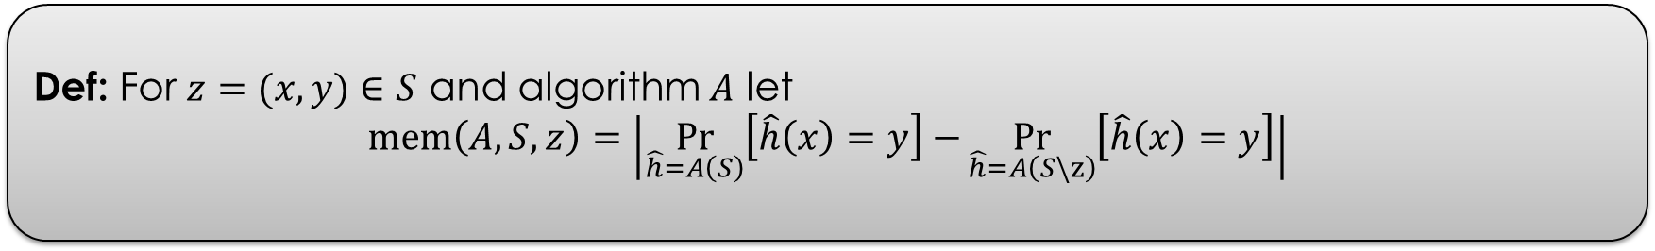
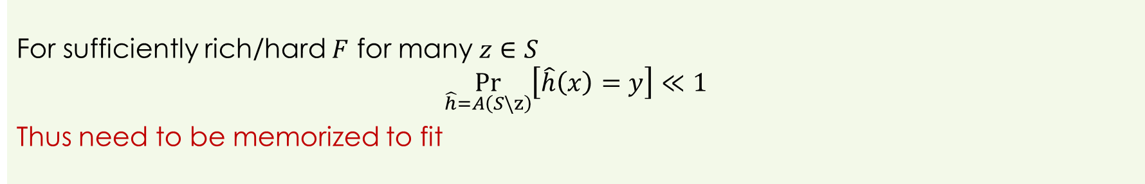
Fitting and memorization
Def: For $z=(x,y)∈S$ and algorithm $A$ let
$$mem\left(A,S,z\right)=\left|\underset{\hat{h}=A\left(S\right)}{Pr}\left[\hat{h}\left(x\right)=y\right]−\underset{\hat{h}=A\left(S\backslash z\right)}{Pr}\left[\hat{h}\left(x\right)=y\right]\right|$$
For sufficiently rich/hard $F$ for many $z∈S$
$$\underset{\hat{h}=A\left(S\backslash z\right)}{Pr}\left[\hat{h}\left(x\right)=y\right]≪1$$
Thus need to be memorized to fit

Slide 14
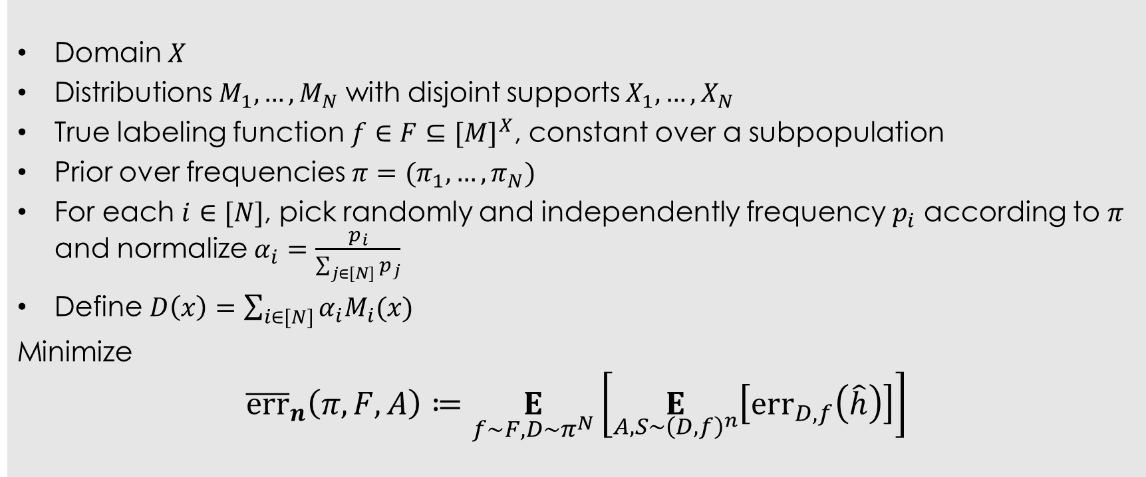
Beyond discrete domains
Domain $X$
Distributions $M_{1},…,M_{N}$ with disjoint supports $X_{1},…,X_{N}$
True labeling function $f∈F⊆{[M]}^{X}$, constant over a subpopulation
Prior over frequencies $π=(π_{1},…,π_{N})$
For each $i∈[N]$, pick randomly and independently frequency $p_{i}$ according to $π$ and normalize $α_{i}=\frac{p_{i}}{\sum_{j∈\left[N\right]}{p_{j}}}$
Define $D\left(x\right)=\sum_{i∈[N]}{α_{i}M_{i}(x)}$
Minimize
$${\overline{err}}_{n}\left(π,F,A\right)≔\underset{f∼F,D∼π^{N}}{E}\left[\underset{A, S∼{\left(D,f\right)}^{n}}{E}\left[{err}_{D,f}\left(\hat{h}\right)\right]\right]$$

Slide 15
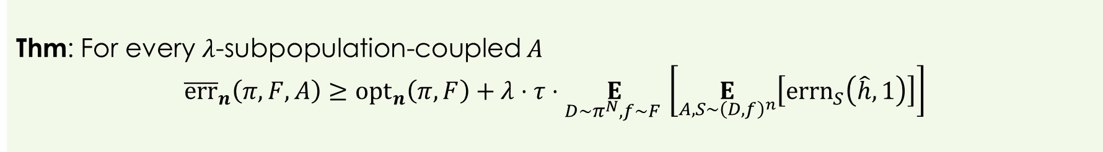
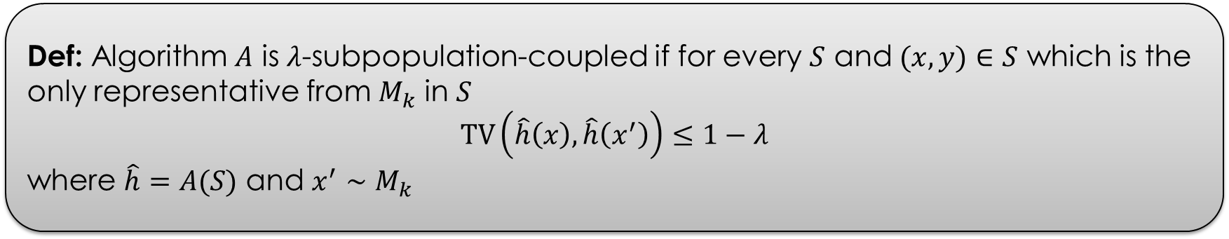
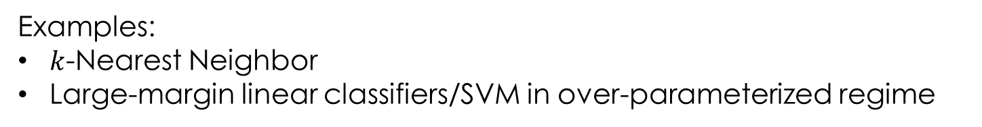
Coupling
Def: Algorithm $A$ is $λ$-subpopulation-coupled if for every $S$ and $(x,y)∈S$ which is the only representative from $M_{k}$ in $S$
$$TV\left(\hat{h}\left(x\right),\hat{h}\left(x^{′}\right)\right)≤1−λ$$
where $\hat{h}=A(S)$ and $x^{′}∼M_{k}$
Thm: For every $λ$-subpopulation-coupled $A$
$${\overline{err}}_{n}\left(π,F,A\right)≥{opt}_{n}\left(π,F\right)+λ⋅τ⋅\underset{D∼π^{N},f∼F }{E}\left[\underset{A,S∼{\left(D,f\right)}^{n}}{E}\left[{errn}_{S}\left(\hat{h},1\right)\right]\right]$$
Examples:
$k$-Nearest Neighbor
Large-margin linear classifiers/SVM in over-parameterized regime

Slide 16
Privacy and memorization
Differentially private algorithms cannot memorize rare examples or fit noise
Do not achieve state-of-the-art error: e.g. 2% on MNIST vs 0.2% non-privately
least accurate
most accurate
[Carlini,Erlingsson,Papernot ’18]

Slide 17

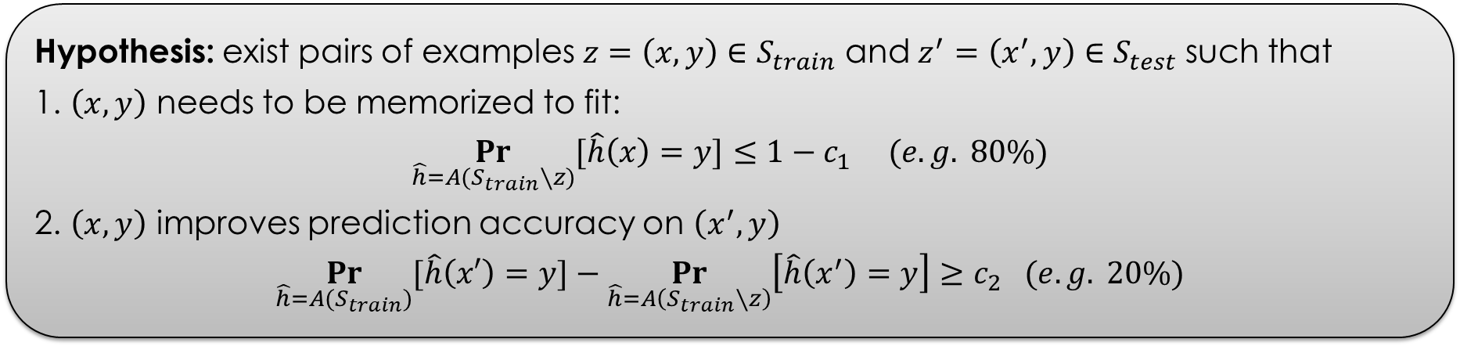
Experiments (with Chiyuan Zhang)
Hypothesis: exist pairs of examples $z=\left(x,y\right)∈S_{train}$ and $z^{′}=\left(x^{′},y\right)∈S_{test}$ such that
1. $\left(x,y\right)$ needs to be memorized to fit:
$$\underset{\hat{h}=A(S_{train}∖z)}{Pr}{[\hat{h}\left(x\right)=y]}≤{1−c}_{1} (e.g. 80\%)$$
2. $\left(x,y\right)$ improves prediction accuracy on $\left(x^{′},y\right)$
$$\underset{\hat{h}=A(S_{train})}{Pr}{[\hat{h}\left(x′\right)=y]}−\underset{\hat{h}=A\left(S_{train}∖z\right)}{Pr}\left[\hat{h}\left(x^{′}\right)=y\right]≥c_{2} (e.g. 20\%)$$
Fraction of such examples is significant
EXAMPLES
FROM THE
LONG TAIL
Computationally prohibitive to find directly
(even on MNIST)

Slide 18
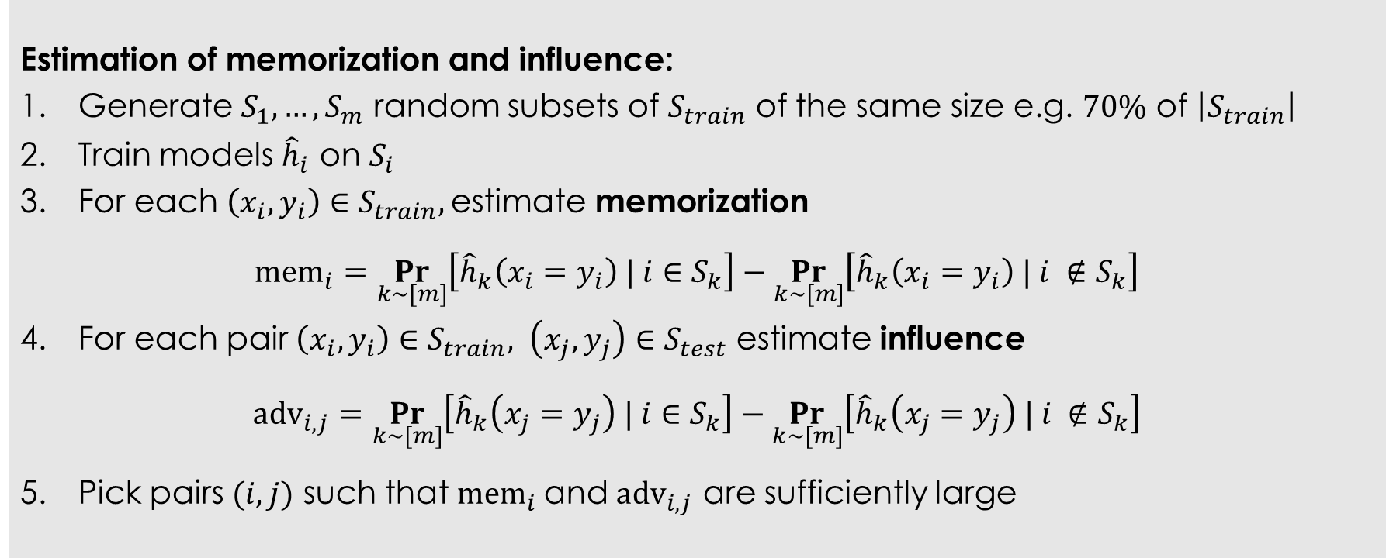
Method
Estimation of memorization and influence:
Generate $S_{1},…,S_{m}$ random subsets of $S_{train}$ of the same size e.g. $70\%$ of $\left|S_{train}\right|$
Train models ${\hat{h}}_{i}$ on $S_{i}$
For each $\left(x_{i},y_{i}\right)∈S_{train},$estimate memorization
$$mem_{i}=\underset{k∼[m]}{Pr}\left[{\hat{h}}_{k}\left(x_{i}=y_{i}\right) | i∈S_{k}\right]−\underset{k∼[m]}{Pr}\left[{\hat{h}}_{k}\left(x_{i}=y_{i}\right) | i ∉S_{k}\right]$$
For each pair $\left(x_{i},y_{i}\right)∈S_{train}, \left(x_{j},y_{j}\right)∈S_{test}$ estimate influence
$$adv_{i,j}=\underset{k∼[m]}{Pr}\left[{\hat{h}}_{k}\left(x_{j}=y_{j}\right) | i∈S_{k}\right]−\underset{k∼[m]}{Pr}\left[{\hat{h}}_{k}\left(x_{j}=y_{j}\right) | i ∉S_{k}\right]$$
Pick pairs $(i,j)$ such that $mem_{i}$and $adv_{i,j}$ are sufficiently large
Still computationally intensive: we use $m$=2,000

Slide 19
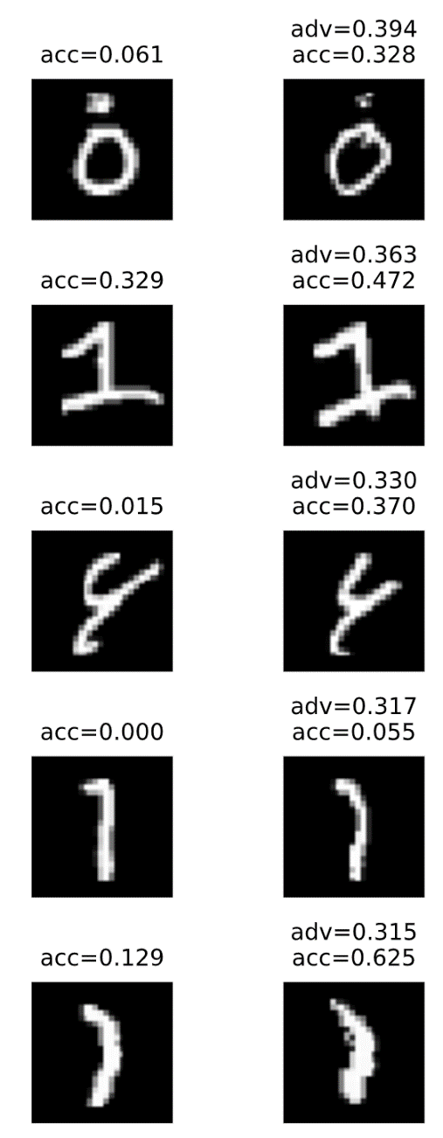
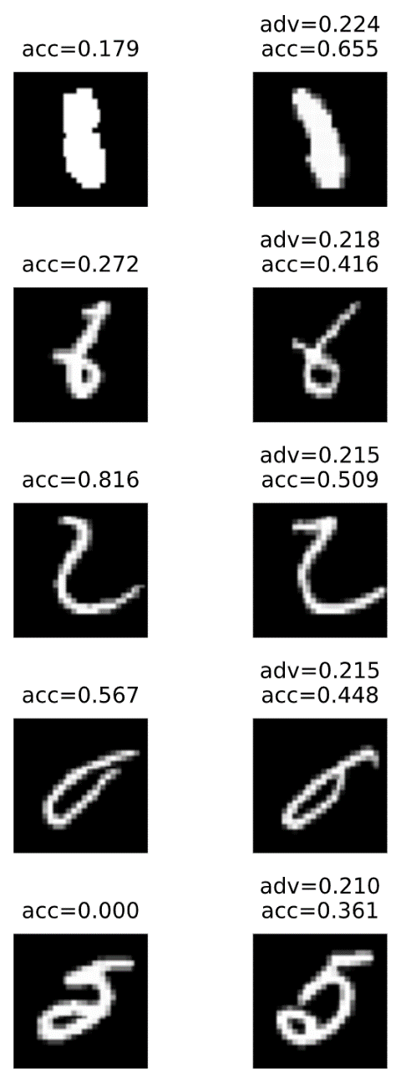
Results (MNIST)
train
test
train
test
MNIST:
50K train; 10K test
10 classes
Algo: SGD on simple CNN
99+% accuracy
70+ examples with
>13% advantage

Slide 20
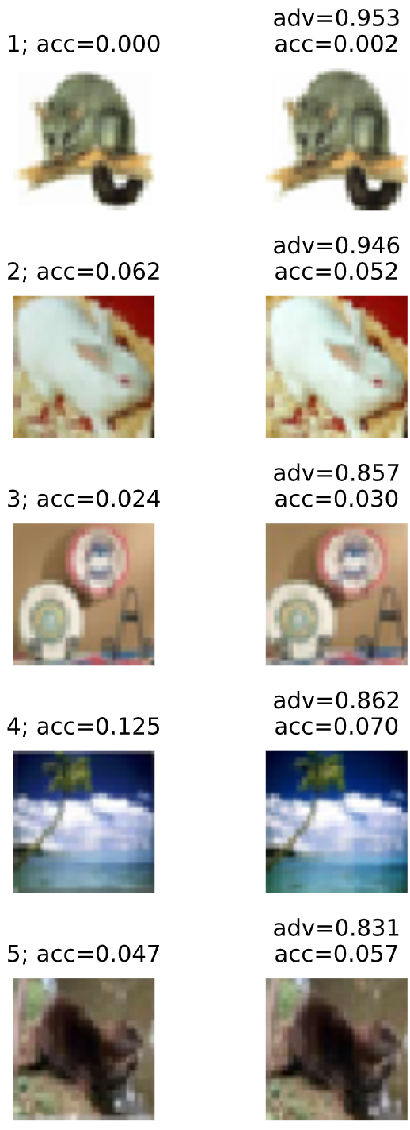
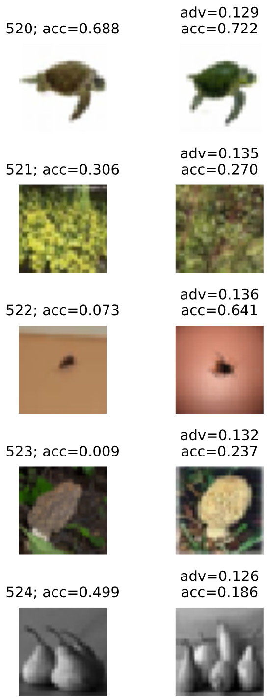
Results (CIFAR-100)
train
test
train
test
CIFAR-100:
50K train; 10K test
100 classes
Algo: Momentum on Inception
67+% accuracy
700+ examples with
>13% advantage

Slide 21
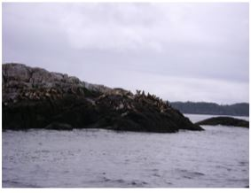
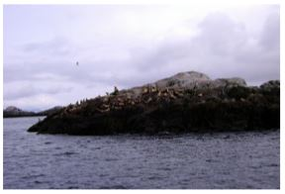


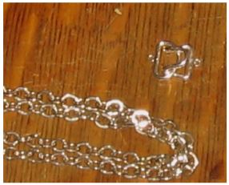
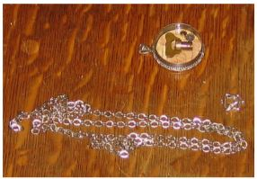
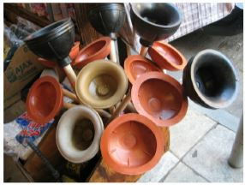
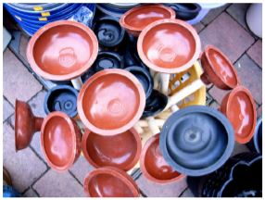
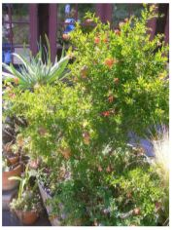
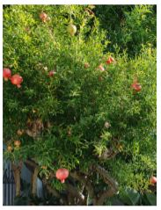
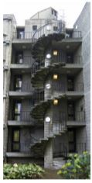

Results (Imagenet-1000)
train
test
train
test
acc=0.037 sea lion adv=0.718
acc=0.802 rubber eraser adv=0.185
Imagenet-1000:
1.2M train; 50K test
1000 classes
Algo: Momentum on ResNet50
69% accuracy
95% train accuracy
acc=0.023 chain adv=0.707
acc=0.619 plunger adv=0.182
1400+ examples with
>16% advantage
acc=0.537 pomegranate adv=0.541
acc=0.065 coil adv=0.181

Slide 22
Conclusions
Label memorization is not explained by prior work
New theory: natural data is long-tailed
Memorization/overfitting is necessary for optimal generalization
Techniques for estimation of memorization and influence
https://arxiv.org/abs/1906.05271 (STOC 2020)
Talk: youtu.be/Fp7cgHRl8Yc
Future work
More faithful theoretical models of data
Insights for better learning algorithms
Other applications of the estimators
Implications for privacy

